Slide 1
Lecture 17: Recap: The data part of ML

Slide 2
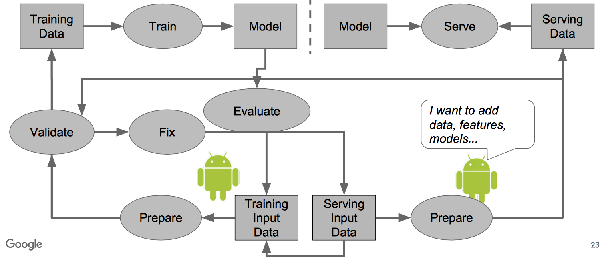
ML in production
Source: [Polyzotis et al., SIGMOD 2017]

Slide 3
So far
Source: [Polyzotis et al., SIGMOD 2017]

Slide 4
Today’s Recap
Data exploration
Data extraction and integration
Dealing with noisy data

Slide 5
1. Data exploration
Section 1

Slide 6
Data visualization
Section 1
Standard Data Visualization Recipe:
Load dataset into data viz tool
Start with a desired hypothesis/pattern (explore combination of attributes)
Select viz to be generated
See if it matches desired pattern
Repeat 3-4 until you find a match

Slide 7
Automate vis recommendations
Section 1
Given a dataset and a task, automatically produce a set of visualizations that are the most “interesting” given the task

Slide 8
Interesting vis
Section 1
A visualization is interesting if it displays
a large deviation from some reference
Task: compare unmarried adults with all adults
Deviation-based Utility
Target
Reference
V1 = SELECT d, f(m) FROM table WHERE target GROUP BY d
V2 = SELECT d, f(m) FROM table WHERE reference GROUP BY d
V₁
V₁
Compare induced probability distributions!
V₂
V₂

Slide 9
DB-inspired optimizations
Section 1
Ranking Visualizations
Query Optimizations
Smart Drill-Down

Slide 10
Ranking Visualizations
Section 1
Across all (d, m, f), where
V1 = SELECT d, f(m) FROM table WHERE target GROUP BY d
V2 = SELECT d, f(m) FROM table WHERE reference GROUP BY d
Vi = (d: dimension, m: measure, f: aggregate)
10s of dimensions, 10s of measures, handful of aggregates
2* d * m * f
100s of queries for a single user task!
Can be even larger. How?

Slide 11
Query Optimizations
Section 1
Combine aggregate queries on target and ref
Combine multiple aggregates
(d1, m1, f1), (d1, m2, f1) → (d1, [m1, m2], f1)
Combine multiple group-bys*
(d1, m1, f1), (d2, m1, f1) → ([d1, d2], m1, f1)
Could be problematic…
Parallel Query Execution

Slide 12
Query Optimizations
Section 1
Combine aggregate queries on target and ref
Combine multiple aggregates
(d1, m1, f1), (d1, m2, f1) → (d1, [m1, m2], f1)
Combine multiple group-bys*
(d1, m1, f1), (d2, m1, f1) → ([d1, d2], m1, f1)
Could be problematic…
Parallel Query Execution

Slide 13
Smart Drill-Down
Section 1
Smart Drill-Down
Present k most interesting rules (patterns)
Find interesting portions faster
User tunable
Interactive
Instantiate multiple columns
Complementary functionality!

Slide 14
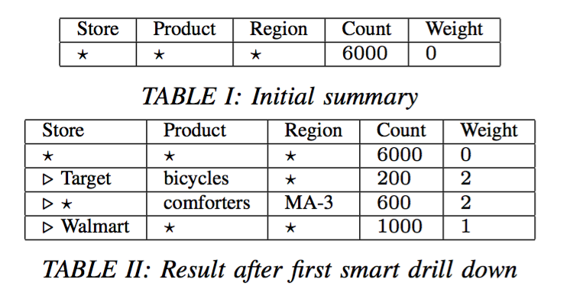
Example
Section 1

Slide 15
Example
Section 1

Slide 16
Example
Section 3

Slide 17
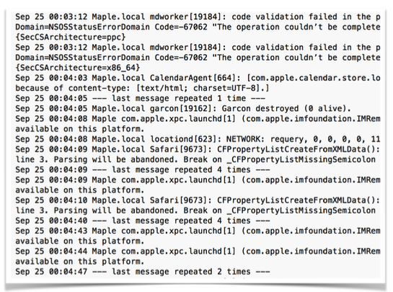
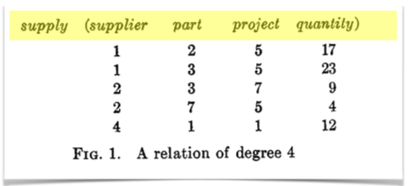
Data Search
Section 3
Data about data
This used to be simple
But schema is gone…
All about metadata!

Slide 18
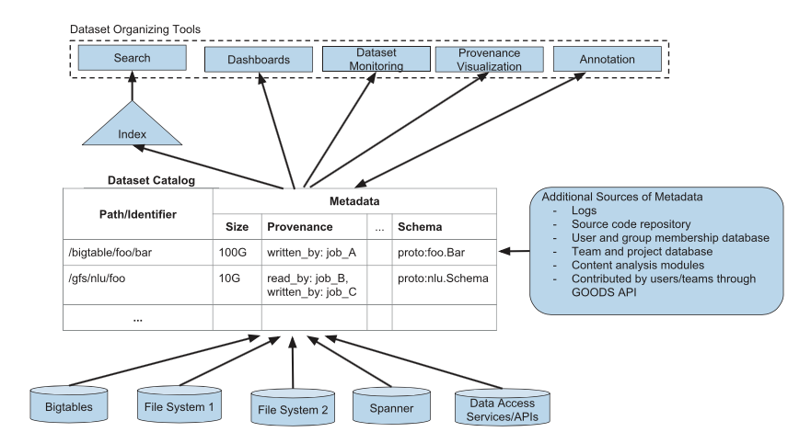
Dataset Catalogues
Section 3

Slide 19
Data versioning
Section 3
Branch, update, merge, transform
Large unstructured or structured datasets
Main challenges:
How can we store thousands of versions of datasets compactly?
How to access any version, on-demand, efficiently?

Slide 20
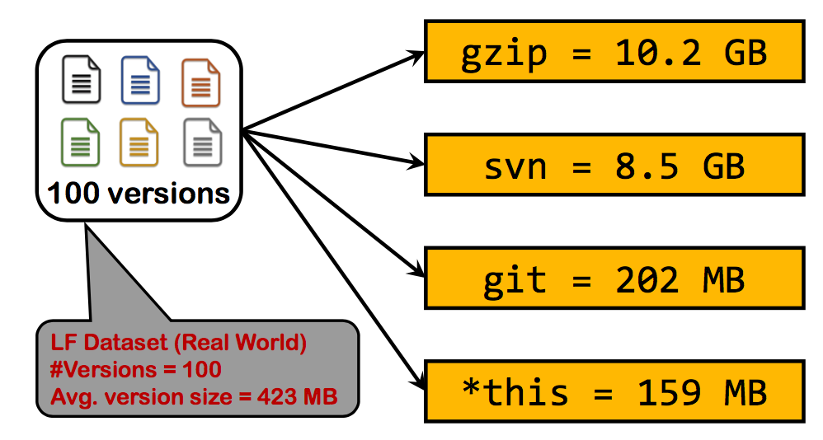
Data versioning
Section 3

Slide 21
Data versioning
Section 3
Given
Set of versions
Partial information about deltas between versions
with
deltas being directed/undirected
deltas having different storage and recreation costs
PROBLEM: Find a storage solution that:
Minimizes total recreation cost within storage budget
Minimizes maximum recreation cost within a storage budget

Slide 22
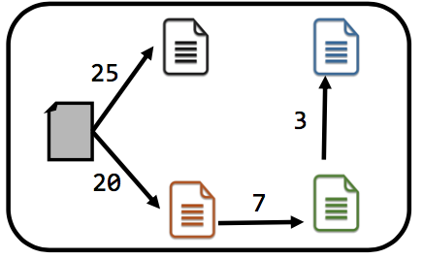
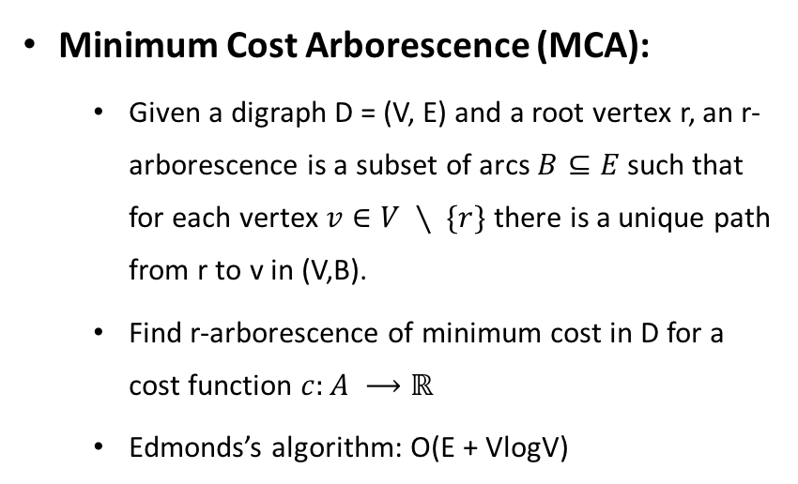
Data versioning
Section 3
Minimum Cost Arborescence (MCA):
Given a digraph D = (V, E) and a root vertex r, an r-arborescence is a subset of arcs $B⊆E$ such that for each vertex $v∈V ∖ \{r\}$ there is a unique path from r to v in (V,B).
Find r-arborescence of minimum cost in D for a cost function $c:A ⟶ℝ$
Edmonds’s algorithm: O(E + VlogV)
Version 1: Minimize Storage Cost
Recreation Cost: No constraints

Slide 23
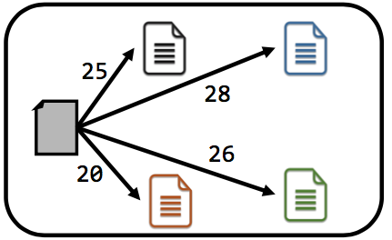
Data versioning
Section 3
Shortest Path Tree (SPT)
Dijkstra’s algorithm: O(E VlogV)
Version 2: Minimize Recreation Cost
Storage Cost: No constraints

Slide 24
2. Data extraction and integration
Section 2

Slide 25

Structure in data is great…
Section 2

Slide 26
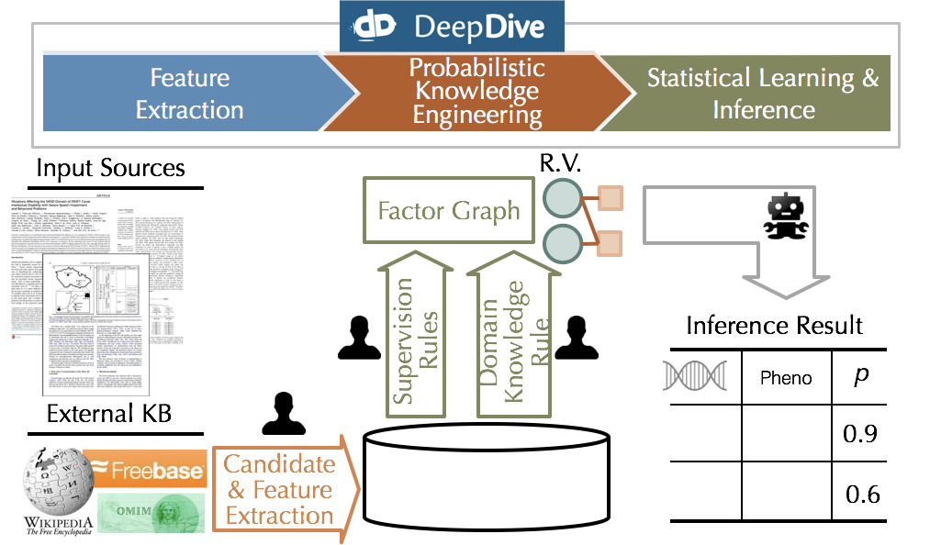
KBC workflow
Section 2

Slide 27
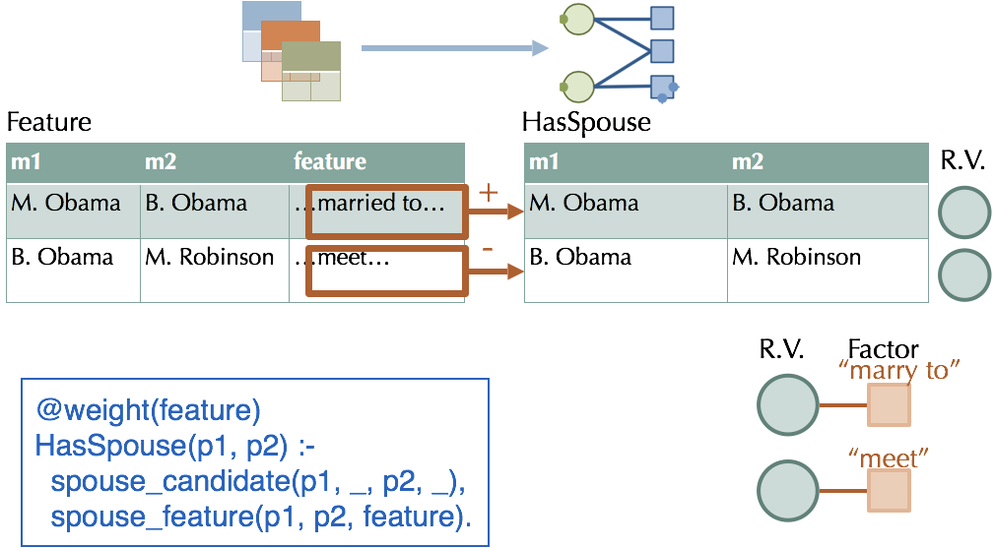
Probabilistic knowledge engineering
Section 2

Slide 28
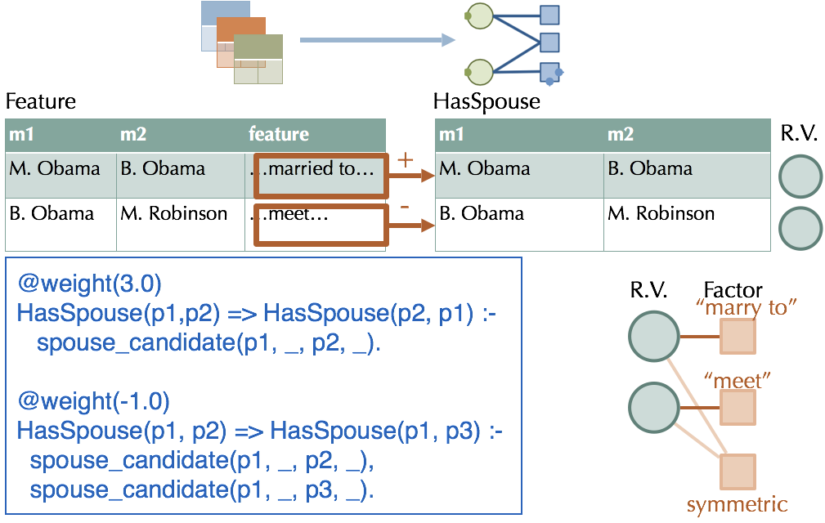
Probabilistic knowledge engineering
Section 2

Slide 29
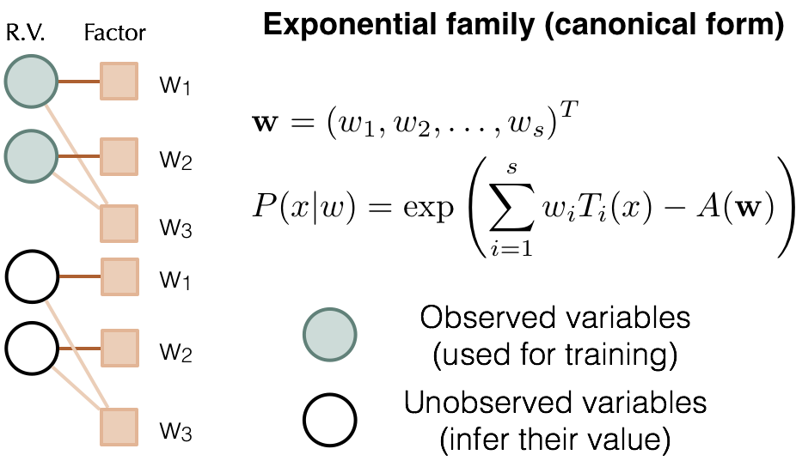
Factor graphs
Section 2

Slide 30
Inference with Gibbs sampling
Section 2

Slide 31
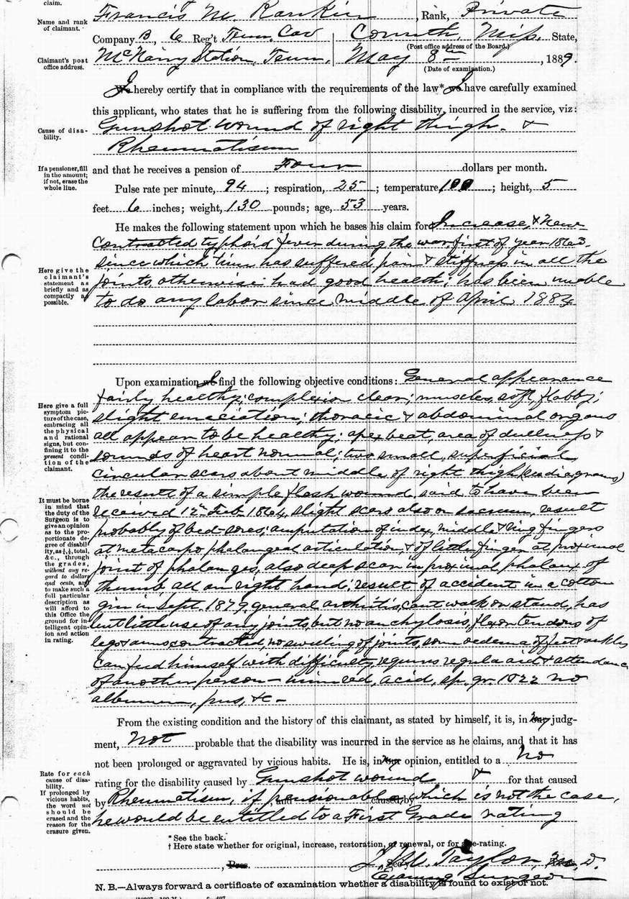
Biggest pain point in trained systems
Section 2
Collection
Labeling
Training
Representation Learning
True
False
New pain point, new injection point

Slide 32
Data programming
Section 2
Input: Labeling Functions,
Unlabeled data
Generative Model
Noise-Aware Discriminative Model
Ex. Application: Knowledge Base Creation (KBC)
DOMAIN EXPERT
def lf1(x):
cid = (x.chemical_id, x.disease_id)
return 1 if cid in KB else 0
$$λ_{1}$$
h_{1,1}
x_{1,1}
def lf2(x):
m = re.search(r’.*cause.*’, x.between)
return 1 if m else 0
y₁
h_{1,2}
$$λ_{2}$$
$$Y$$
x_{1,2}
Output: Probabilistic Training Labels
h_{1,3}
def lf3(x):
m = re.search(r’.*not cause.*’, x.between)
return 1 if m else 0
$$λ_{3}$$
1
2
3
Users write labeling functions to generate noisy labels
We model the labeling functions’ behavior to de-noise them
We use the resulting prob. labels to train a model

Slide 33
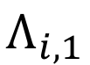
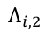
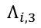
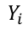
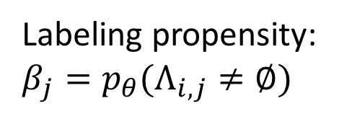
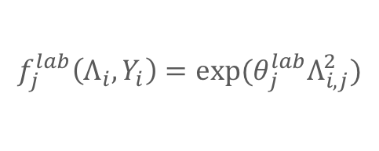
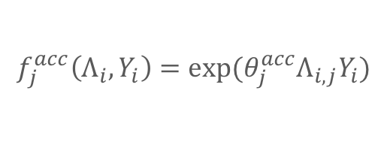
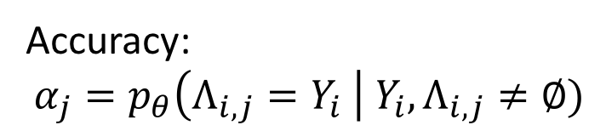
Basic generative labeling model
Section 2
Labeling propensity:
$$β_{j}=p_{θ}(Λ_{i,j}≠∅)$$
$$Λ_{i,1}$$
$$f_{j}^{lab}\left(Λ_{i},Y_{i}\right)={{exp⁡(θ}_{j}^{lab}Λ}_{i,j}^{2})$$
Accuracy:
$$α_{j}=p_{θ}\left(Λ_{i,j}=Y_{i} \right| Y_{i},Λ_{i,j}≠∅)$$
$$Λ_{i,2}$$
$$Y_{i}$$
$$f_{j}^{acc}\left(Λ_{i},Y_{i}\right)=exp⁡(θ_{j}^{acc}Λ_{i,j}Y_{i})$$
$$Λ_{i,3}$$
Correlations

Slide 34
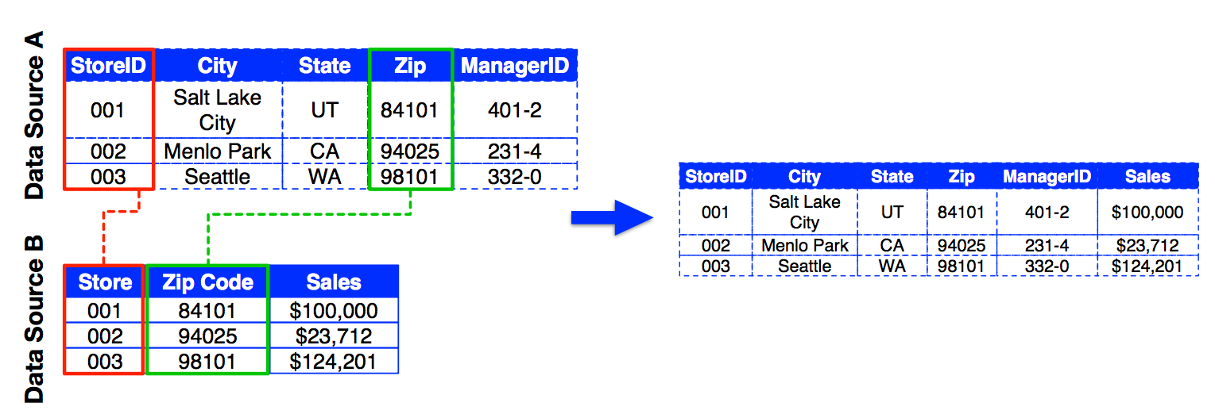
Data integration: Combining multiple data sources
Section 2
Step 1: Schema Alignment
Step 2: Entity Resolution
Step 3: Data Fusion

Slide 35
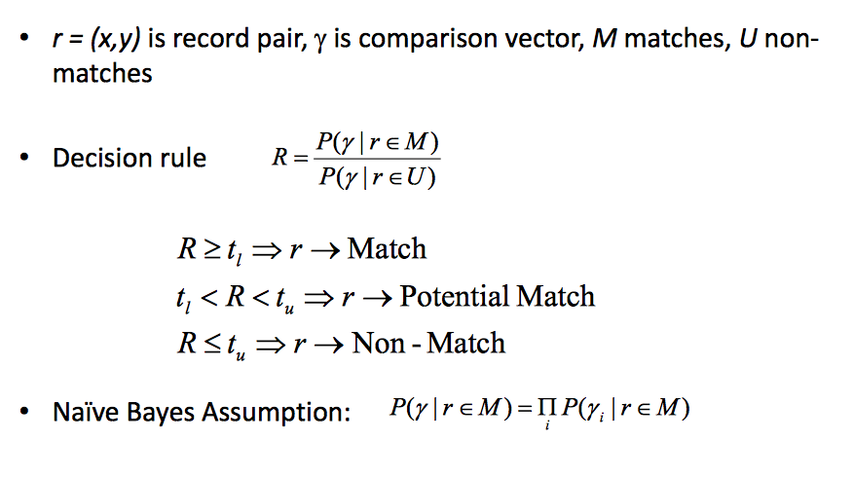
Fellegi & Sunter Model
Section 2

Slide 36
ML Pairwise Approaches
Section 2
Supervised ML algorithms:
Decision trees
Support vector machines
Ensembles of classifiers
Conditional random fields
Issues:
Training set generation
Imbalanced classes – many more negatives than positives (even after eliminating obvious non-matches with Blocking)

Slide 37
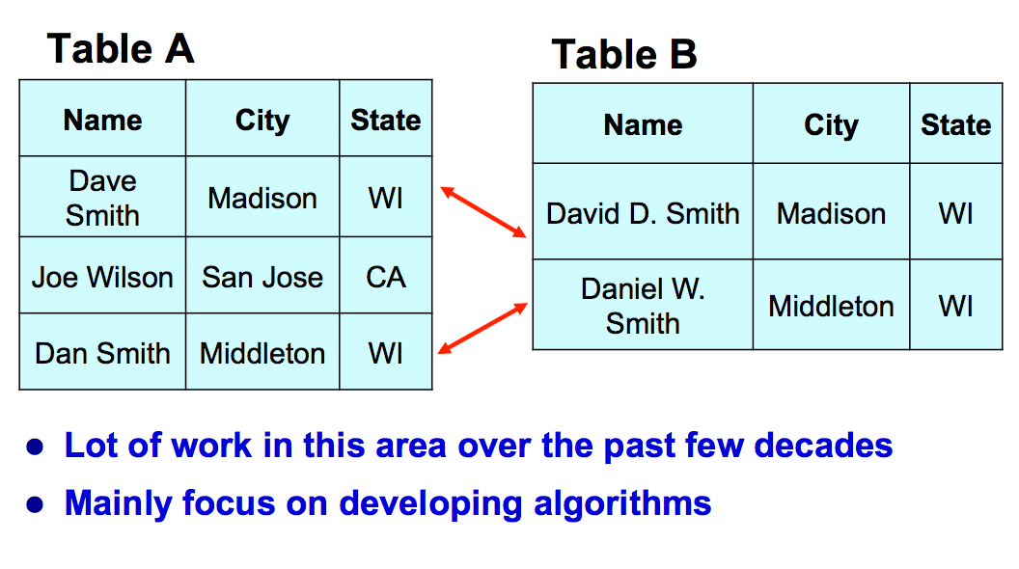
Entity Matching
Section 2

Slide 38
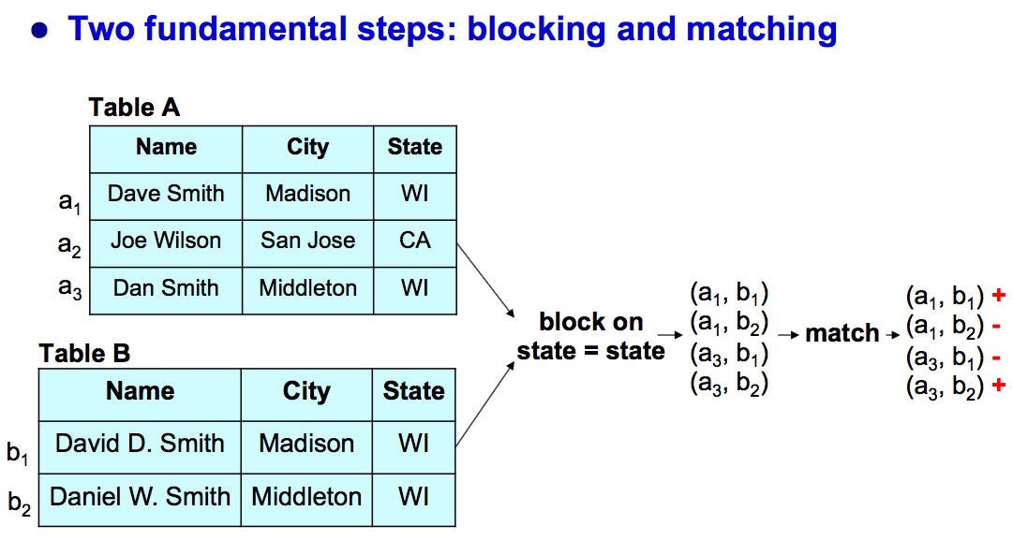
EM systems
Section 2

Slide 39
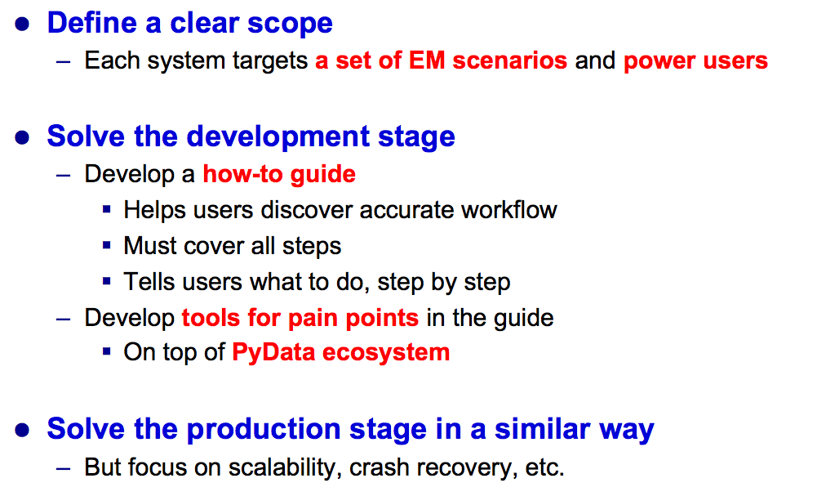
Magellan
Section 2

Slide 40
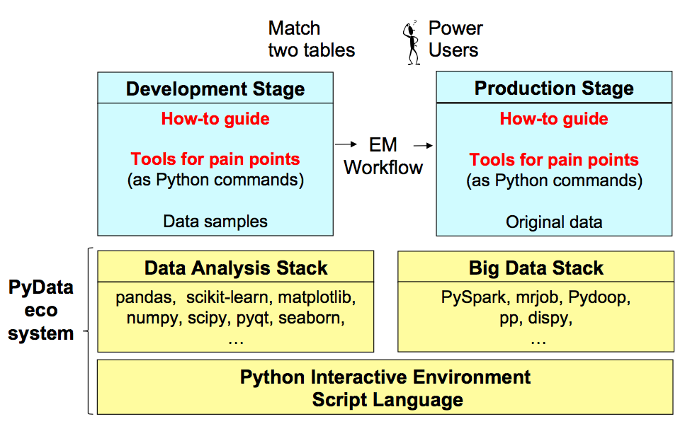
The Magellan Architecture
Section 2

Slide 41
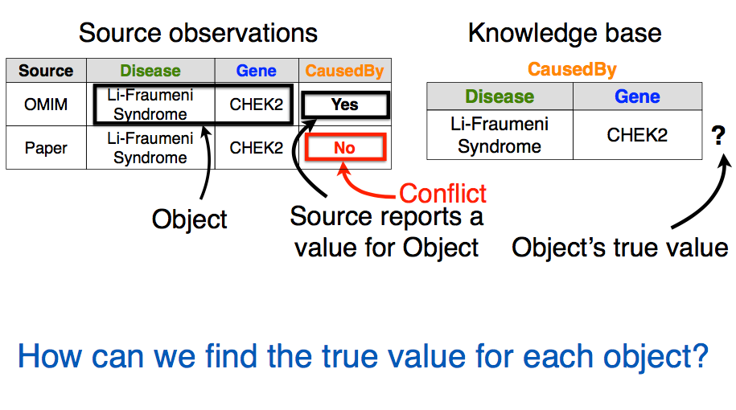
Data fusion
Section 2

Slide 42
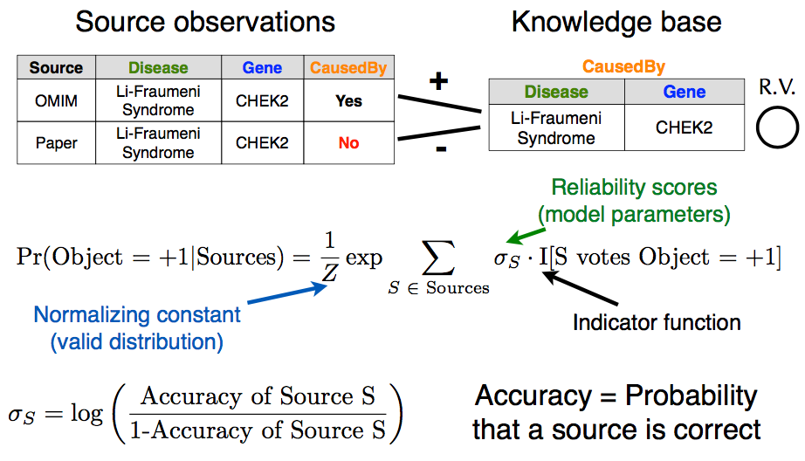
Probabilistic Models for Data Fusion
Section 2

Slide 43
3. Dealing with noisy data
Section 3

Slide 44
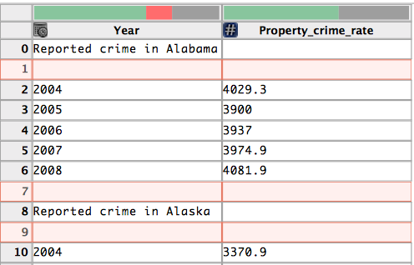
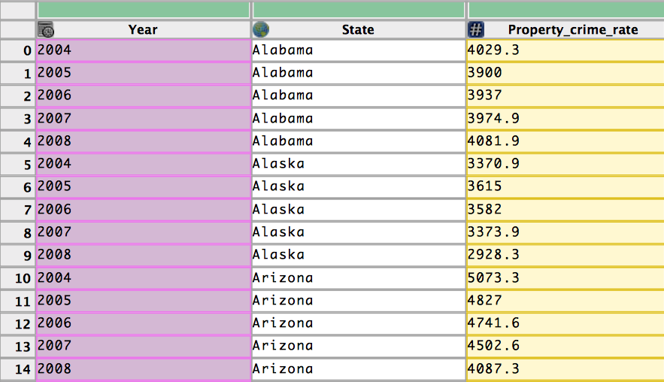
Data wrangling
Section 3

Slide 45
Challenges
Section 3
Transforms for restructuring/validating data can be complicated to specify in scripts.
e.g. Regular expressions to split strings, validate data format.
Reuse and revision of transforms for data updates and changing schemas not possible with scripts or manual editing.
Data wrangling should also output a record of transforms used.

Slide 46
Data Wrangler
Section 3
Transforms for restructuring/validating data can be complicated to specify in scripts.
e.g. Regular expressions to split strings, validate data format.
Reuse and revision of transforms for data updates and changing schemas not possible with scripts or manual editing.
Data wrangling should also output a record of transforms used.

Slide 47
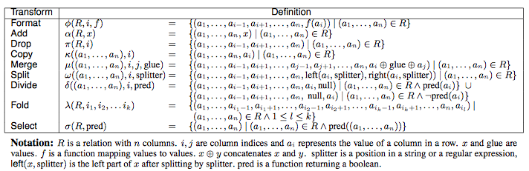
Transformations over relational data
Section 3

Slide 48
Inferring transform parameters from user interaction
Section 3
Infer three types of transform parameter: row, column or text selection
For each type, enumerate possible parameter values, resulting in a collection of inferred parameter set.
Parameter’s value is independent of each other.
row selection is based on row indices and predicate matching.
column selection returns columns users have interacted with.
text selection is either simple index ranges or inferred regular expressions

Slide 49
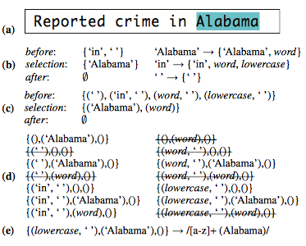
Regular expression inference
Section 3

Slide 50
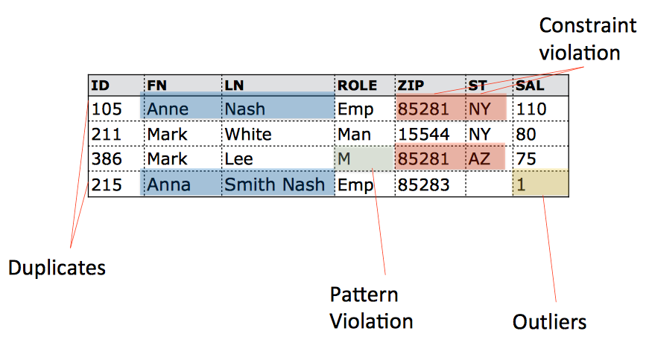
What is a Data Error?
Section 3

Slide 51
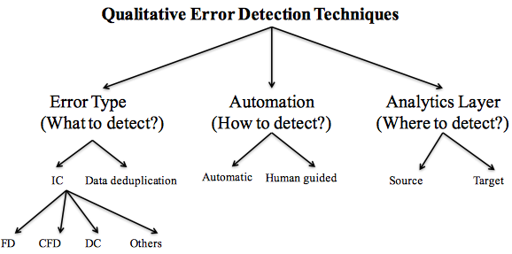
Error Detection Taxonomy
Section 3

Slide 52
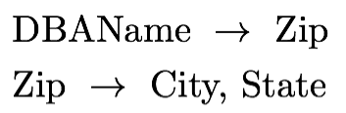
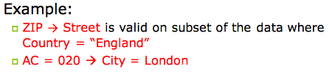
FDs and CFDs
Section 3
Functional dependency (FD):
Conditional Functional Dependency (CFD):
A functional dependency on a subset of the data

Slide 53
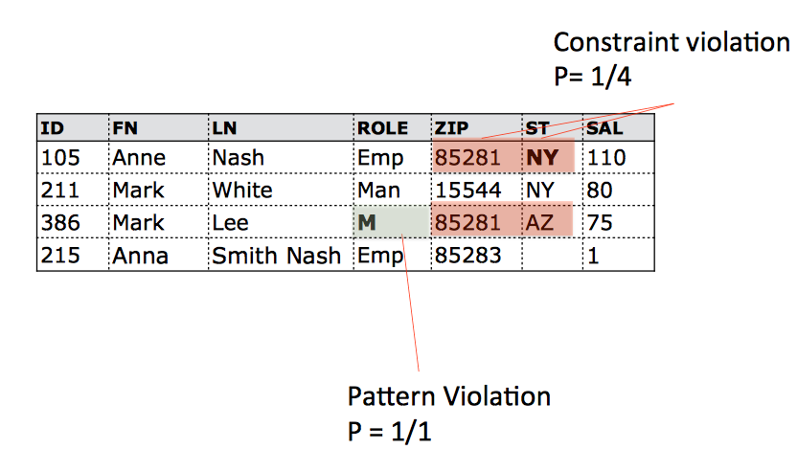
Lots of Detectors
Section 4

Slide 54
How to automate?
Section 3
Most automatic repairing techniques adopt the “minimality” of repairs principle
Repairing techniques in practice are manual and semi-automatic at best

Slide 55
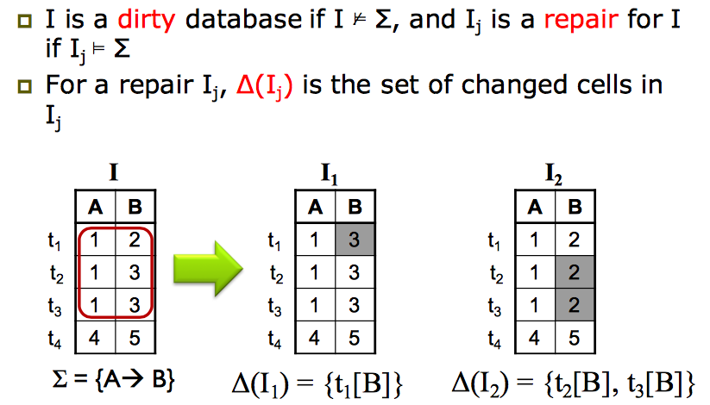
Data repairs by Value Updates
Section 3

Slide 56
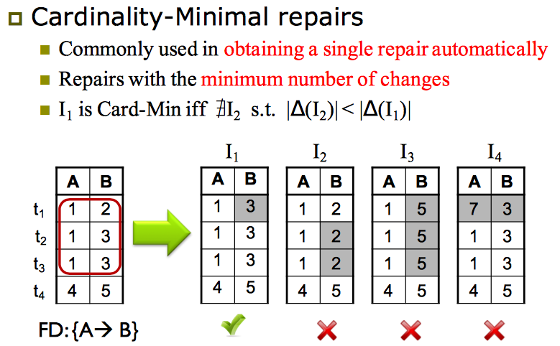
Data repairs by Value Updates
Section 3

Slide 57
Probabilistic Data Repairs
Section 3

Slide 58
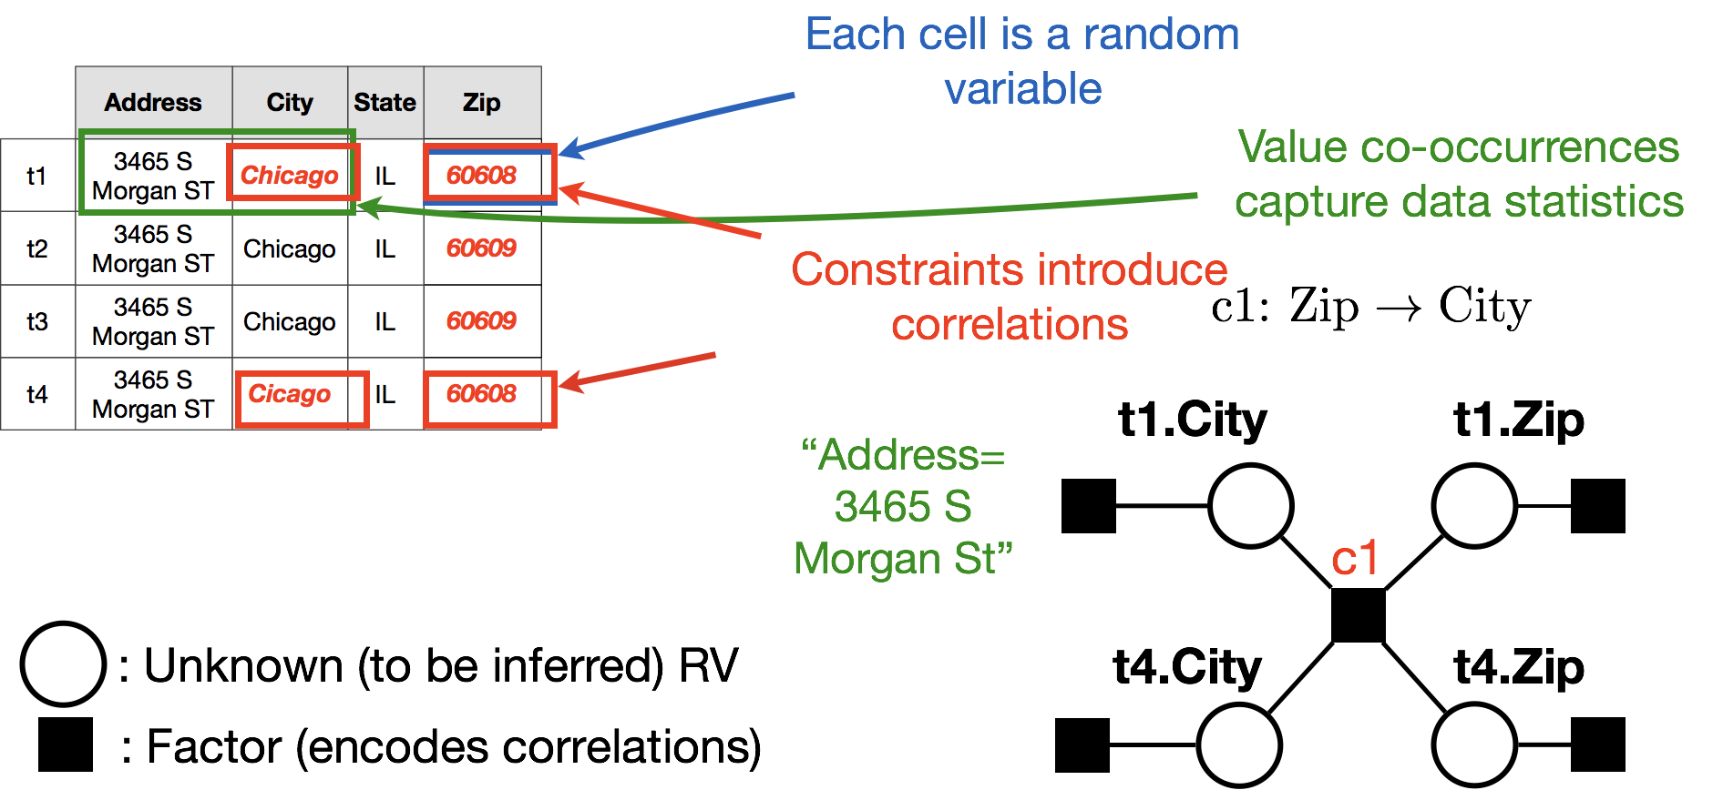
A model for data repairs
Section 3

Slide 59
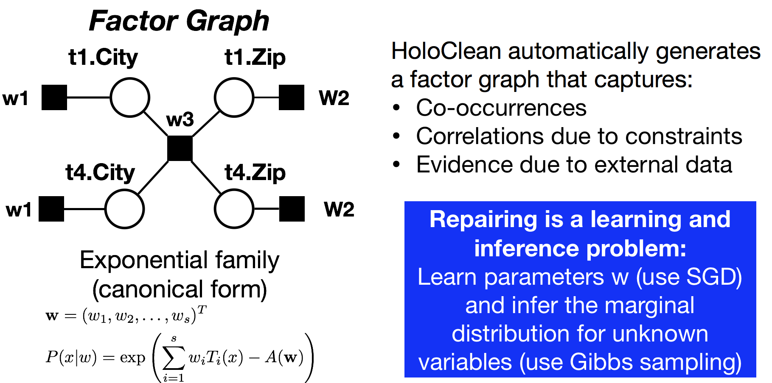
A model for data repairs
Section 3

Slide 60
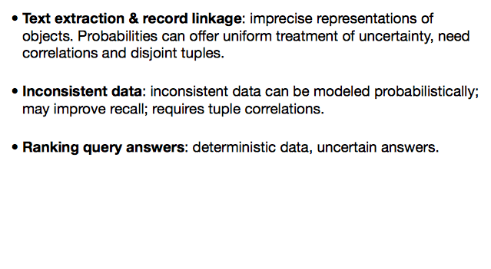
Need to deal with noise
Section 3

Slide 61
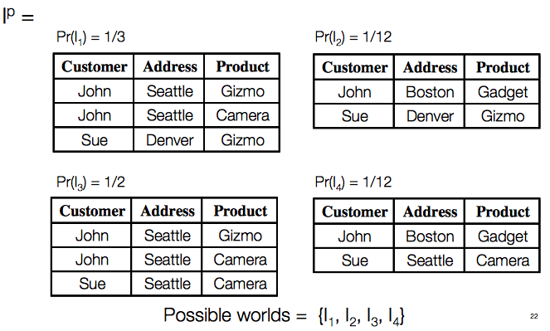
Possible world semantics
Section 3

Slide 62
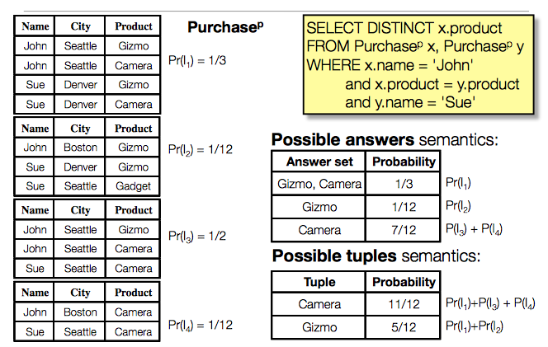
Query Semantics
Section 2

Slide 63
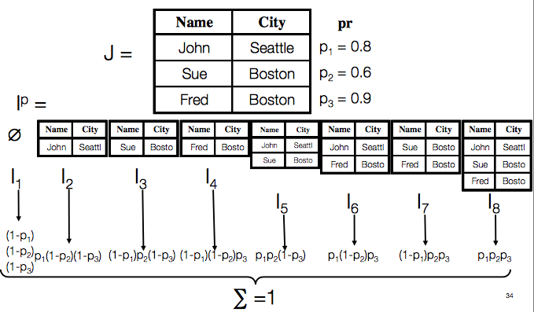
Tuple Prob. -> Possible Worlds
Section 3

Slide 64
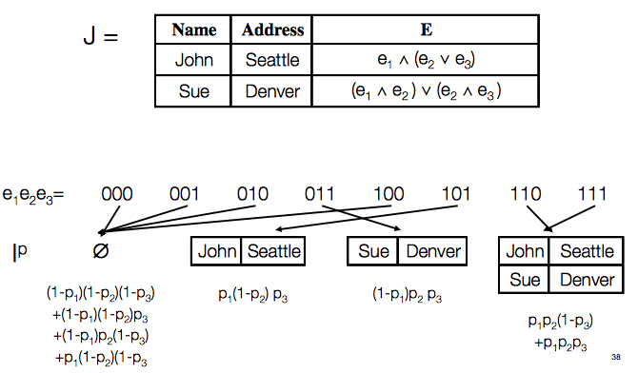
Intensional DB => Possible Worlds
Section 3

Slide 65
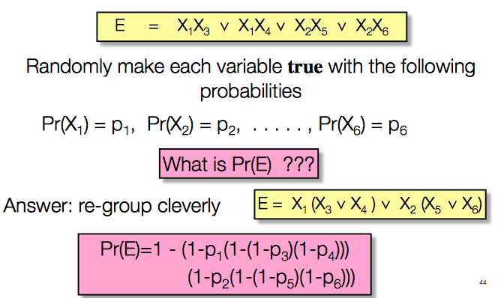
Probability of boolean expressions
Section 4

Slide 66
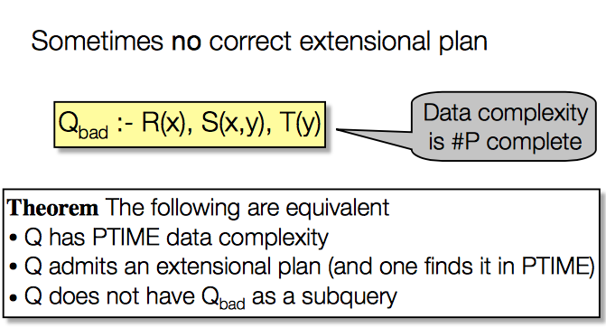
Query complexity
Section 4

Slide 67
Summary and next part of class
Source: [Polyzotis et al., SIGMOD 2017]

